Slide 1

SUPERMARKET SALES ANALYSIS
PAVAN KALYAN
SRI VARSHA
SIVA NAGA RAJU

Slide 2
CONTENTS :
ABSTRACT
INTRODUCTION
MOTIVATION
KEYWORDS AND DEFINITIONS
METHODOLOGIES
RESULTS
CONCLUSION

Slide 3
ABSTRACT :
Supermarkets are expanding in most populated cities, and market competition is fierce. Future sales forecasting is an essential component of any business. Accurate forecasting of future sales assists businesses in developing and improving business strategies, as well as gaining proper market knowledge. Companies can use standard sales projections to analyze historical scenarios and then apply client purchases. Inferences are used prior to budgeting to detect shortfalls and weaknesses, as well as to develop a good strategy for the following year. A thorough understanding of previous opportunities enables one to plan for future market demands and increase one's chances of success. The dataset is one of the historical sales of a supermarket company that was recorded in three different branches over a three-month period. Predictive data analytics methods are easy to apply with this dataset.

Slide 4
INTRODUCTION :
CONTEXT :
The growth of supermarkets in most populated cities are increasing and market competitions are also high. The dataset is one of the historical sales of supermarket company which has recorded in 3 different branches for 3 months data. Predictive data analytics methods are easy to apply with this dataset.
ATTRIBUTE INFORMATON
Invoice id : computer generated sales slip invoice identification number
Branch : Branch of supercentre ( 3 branches are available identified by A,B,C).
Customer type : Type of customers, recorded by the members for customers using member card and normal for without member card.

Slide 5
INTRODUCTION :
City : Location of supercentres
Gender : Gender type of customer
Product line : General item categorization groups-Electronic accessories, Fashion accessories , Food and beverages , Health and beauty, Home and lifestyle , Sports and t travel.
Unit price : Price of each product in $
Quantity : Number of products purchased by customer.
Tax:5% tax fee for customer buying.

Slide 6
INTRODUCTION :
Total : Total price including tax.
Date : Date of purchase(Record available from January 2019 to March 2019)
Time : Purchase time(10am to 9pm)
Payment : Payment used by customer for purchase (3 methods are available cash,credit card and E-wallet)
COGS: Cost of goods sold
Gross margin percentage : Gross margin percentage.
Rating: customer satisfaction rating on their overall shopping experience(On a scale of 1 to 10)

Slide 7
ACKNOWLEDGEMENT & PURPOSE :
Thanks to all who take time and energy to perform kernels with this dataset and reviewers. This dataset can be used for predict the future sales of supermarket. The Machine Learning Techniques we used in this project are Linear Regression, K-nearest Neighbors, Support Vector Regression, Decision Tree Regression, Long Short-term Memory Regression etc.

Slide 8
MOTIVATION :
The success of a supermarket can be gauged by its sales. The growth of retail store & supermarket sales is directly proportional to the customer experience as sales are linked to consumer satisfaction. The higher the consumer satisfaction, the better your sales performance will be.
Inventory is an important asset sitting on the shelves of the supermarket. It plays an instrumental role in the fate of the store.
Strong desire, the most important element in sales, will provide the incentive to make the changes even when it is difficult or uncomfortable." Commitment is having a plan to achieve that goal. "Commitment is a measure of whether you will do whatever it takes to achieve success in sales.

Slide 9
KEYWORDS & DEFINITIONS :
MACHINE LEARNING : Machine learning is a subfield of artificial intelligence, which is broadly defined as the capability of a machine to imitate intelligent human behavior.
REGRESSION : Regression is a technique for investigating the relationship between independent variables or features and a dependent variable or outcome.
DATASET : A collection of related sets of information that is composed of separate elements but can be manipulated as a unit by a computer.
ALGORITHM : A process or set of rules to be followed in calculations or other problem-solving operations, especially by a computer.

Slide 10
METHODOLOGIES :
1. DATA COLLECTION
2. DATA PRE-PROCESSING
3. EXPLORATORY DATA ANALYSIS
4. MODEL FITTING & EVALUATION
5. RESULTS
STEPWISE IMPLEMENTATION OF THE PROJECT :

Slide 11

1. DATA COLLECTION :
Data collection is an essential part of exploratory data analysis. It refers to the process of finding and loading data into our system. Good, reliable data can be found on various public sites or bought from private organizations. Some reliable sites for data collection are Kaggle, GitHub, Machine Learning Repository, etc.
We collected Dataset from Kaggle Database. The link to Dataset is given below :
https://www.kaggle.com/code/apu612/supermarket-sales-prediction/data

Slide 12
2. DATA PREPROCESSING :
Data preprocessing is a process of preparing the raw data and making it suitable for a machine learning model. It is the first and crucial step while creating a machine learning model.
It involves below steps:
Getting the dataset
Importing libraries
Importing datasets
Finding Missing Data
Encoding Categorical Data
Splitting dataset into training and test set
Feature scaling

Slide 13
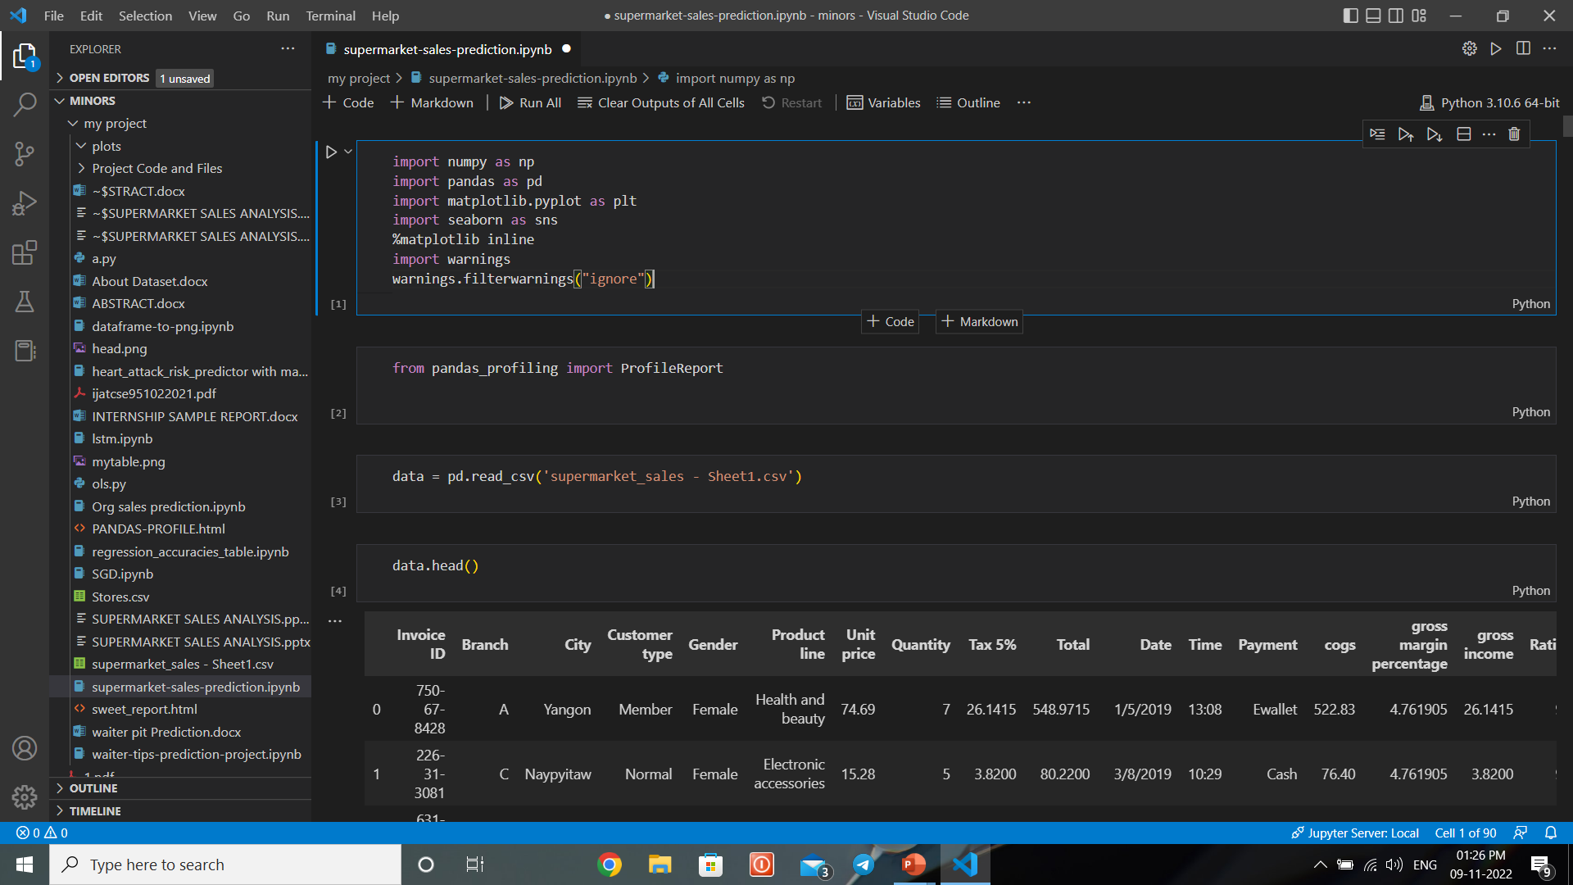
1. Since the collection of Dataset is completed our next step is to convert the raw data into an appropriate form so that we can use them in Machine Learning Algorithms. To do this first we have to import libraries like Pandas, NumPy, Matplotlib, Seaborn etc.
To import the required libraries we use the following code :
2. To import the dataset use the following code :

Slide 14
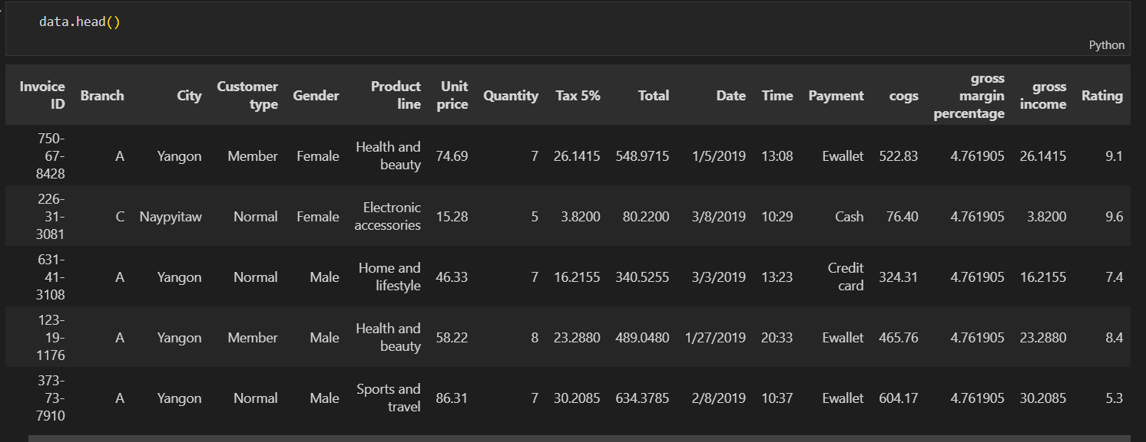
3. To get a brief look into our Dataset we used the following code :
4. Since “Invoice ID” column is of no use to us, we dropped it using data.drop([“Invoice ID”],axis=1) command.

Slide 15
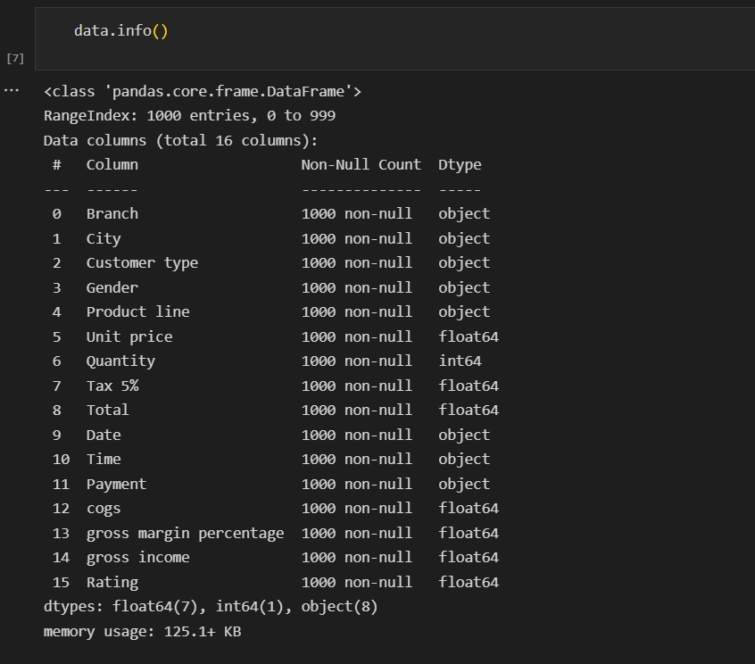
5. To get information about the Dataset, the following code can be useful :

Slide 16
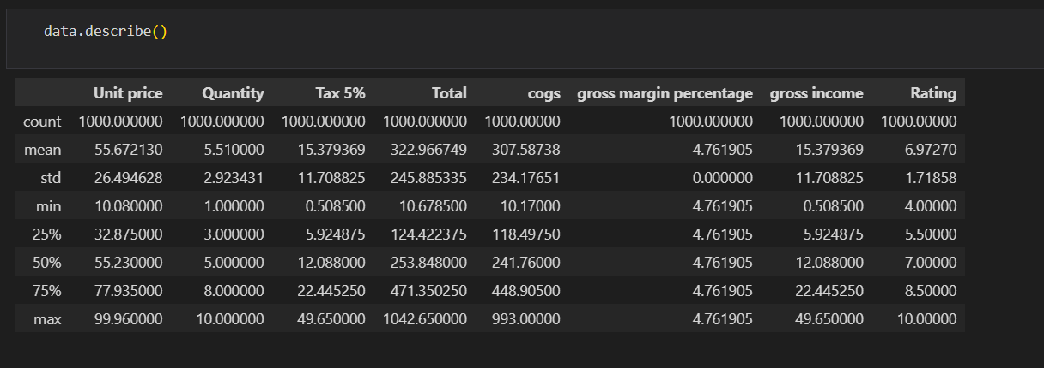
6. Python provides us description about Dataset as follows :
7. Since we don’t have any null values but categorical data , we convert them into numerical data. After conversion the Dataset will be as follows.

Slide 17
3. EXPLORATORY DATA ANALYSIS :
The following plots are used in EDA :
Box plot
Bar plot
Heat Map
Line Plot

Slide 18
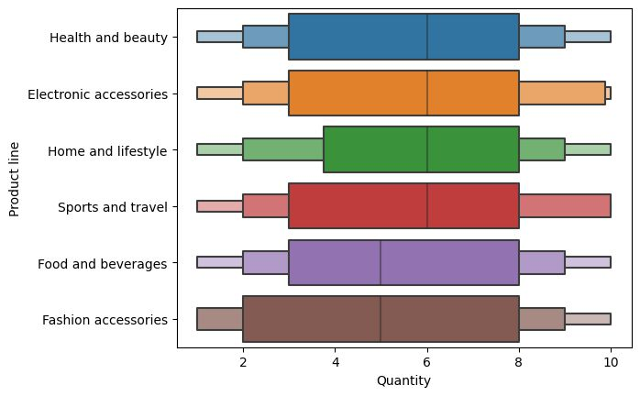
1. Box Plot :

Slide 19
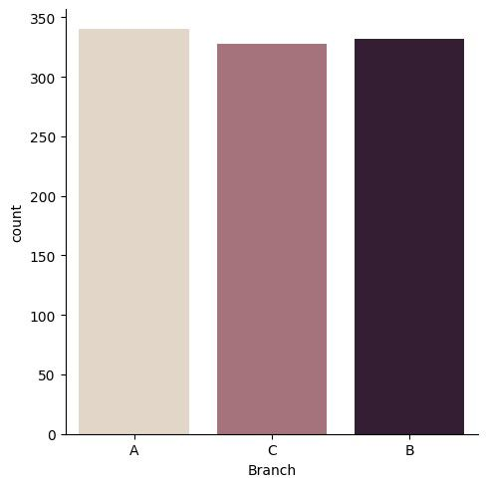
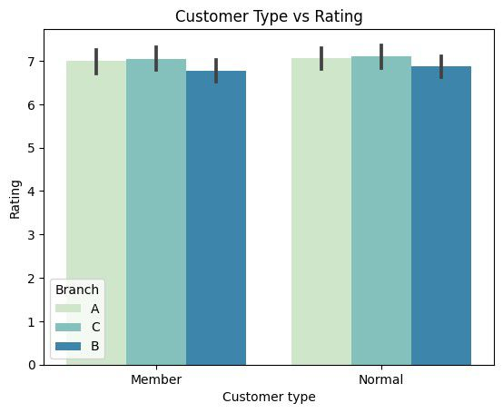
2. Bar Plot :
No. of sales in each Branch
Influence of Customer Type on Ratings

Slide 20
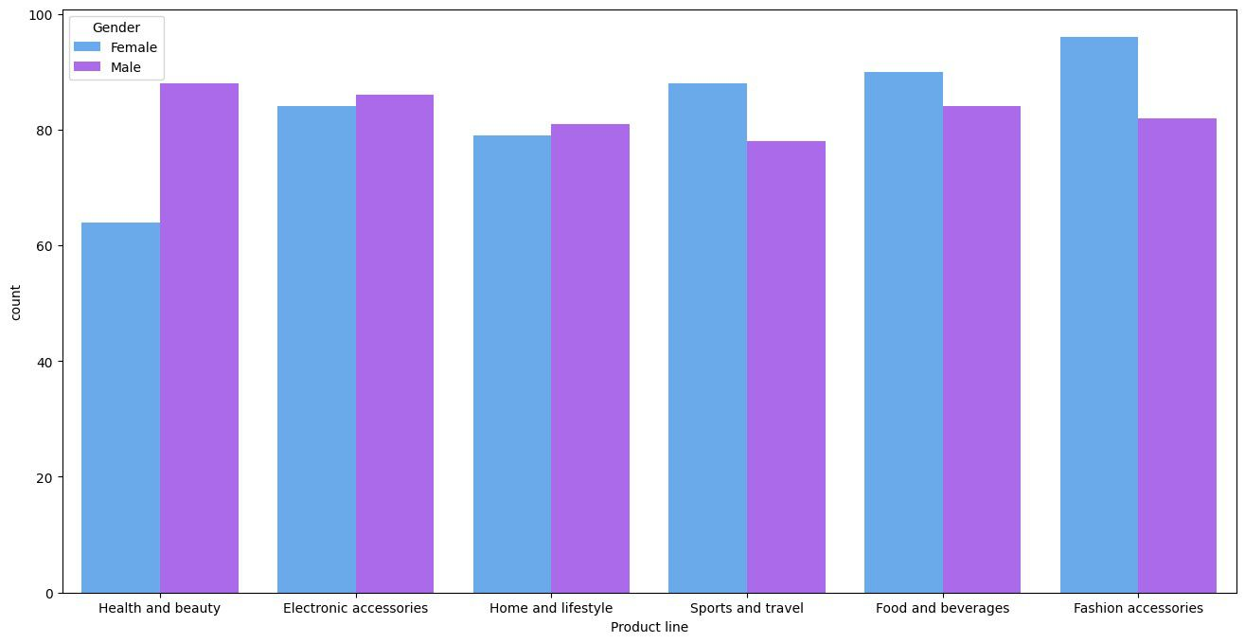
Bar chart classifying the items bought by customers (Gender-wise):

Slide 21
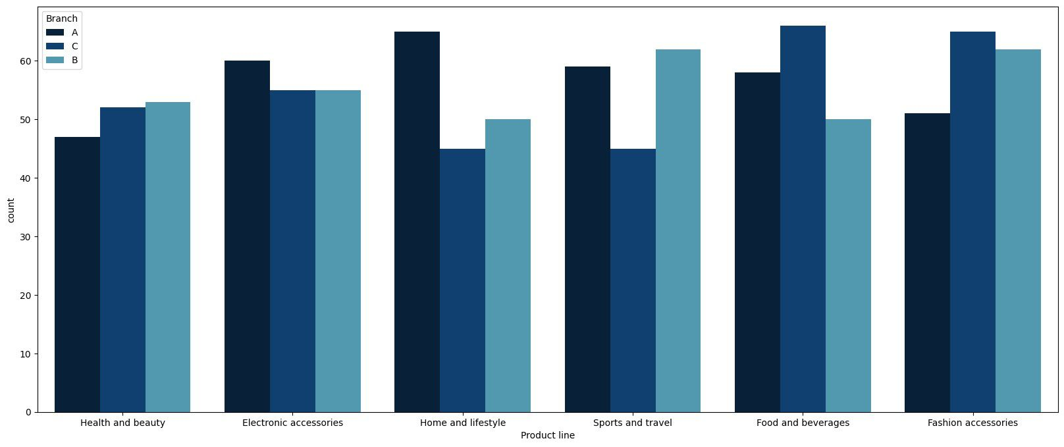
Count of the products sold at each Branch :

Slide 22
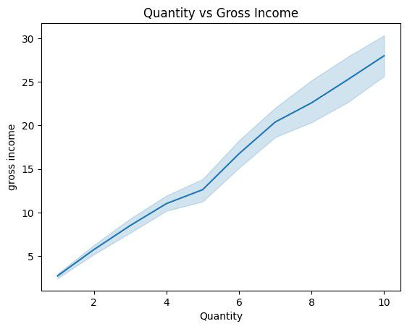

Slide 23
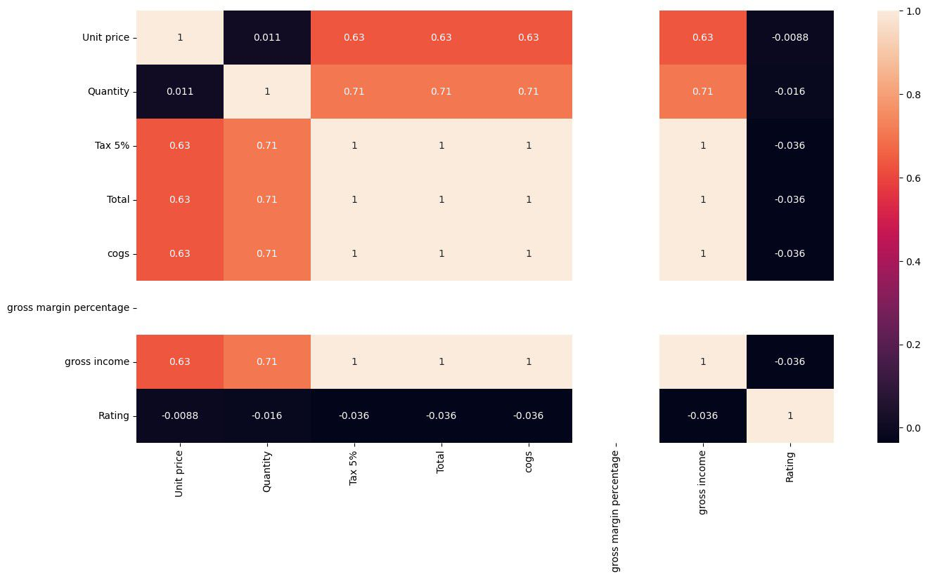
Heat-Map Showing Correlation between variables :

Slide 24
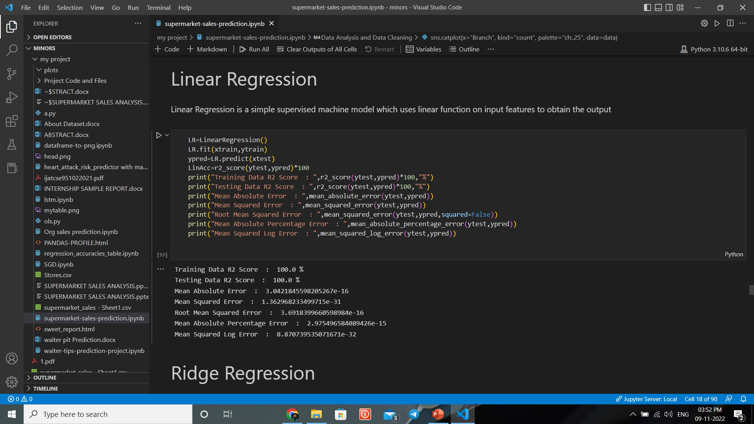
4. MODEL FITTING :

Slide 25
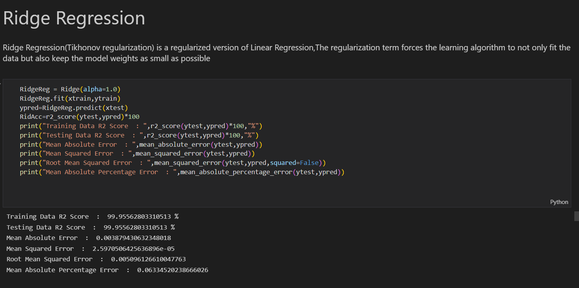

Slide 26
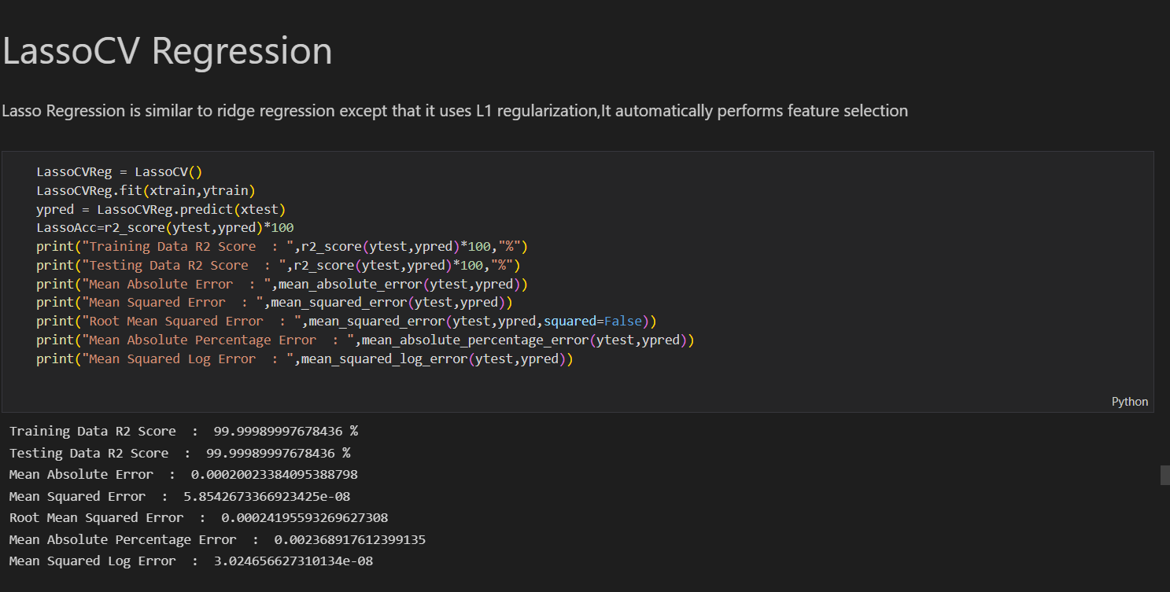

Slide 27
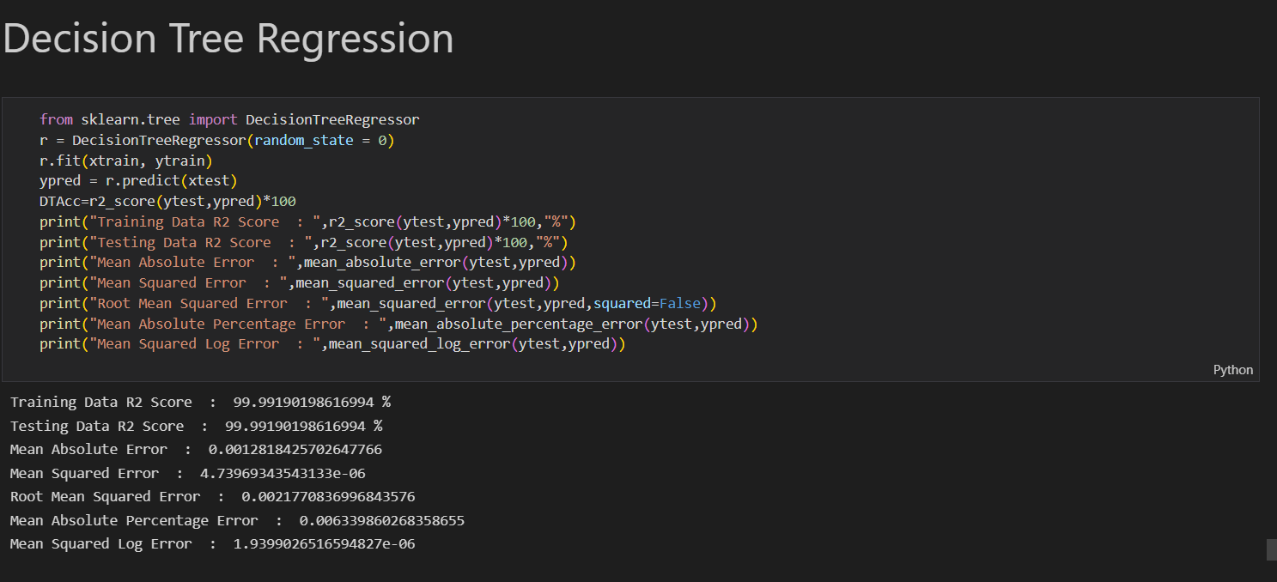

Slide 28
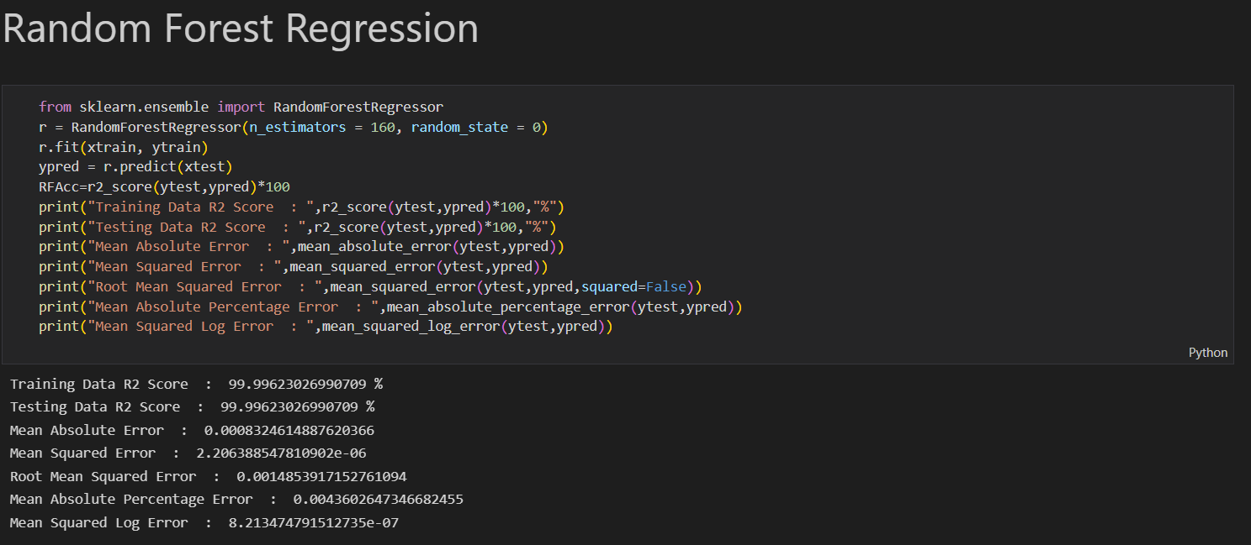

Slide 29
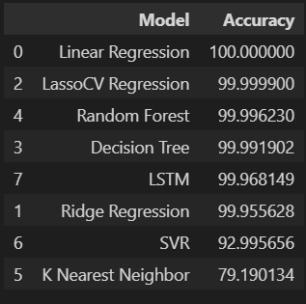
RESULTS :
Out if all the Machine Learning Algorithms, Linear Regression
Model has the highest Accuracy & K-Nearest Neighbor has the
Lowest Accuracy.
The Evaluation metrics used in this Project are :
1. Mean Absolute Error
2. Mean Squared Error
3. Root Mean Squared Error
4. Mean Absolute Percentage Error
5. Mean Squared Log Error.

Slide 30
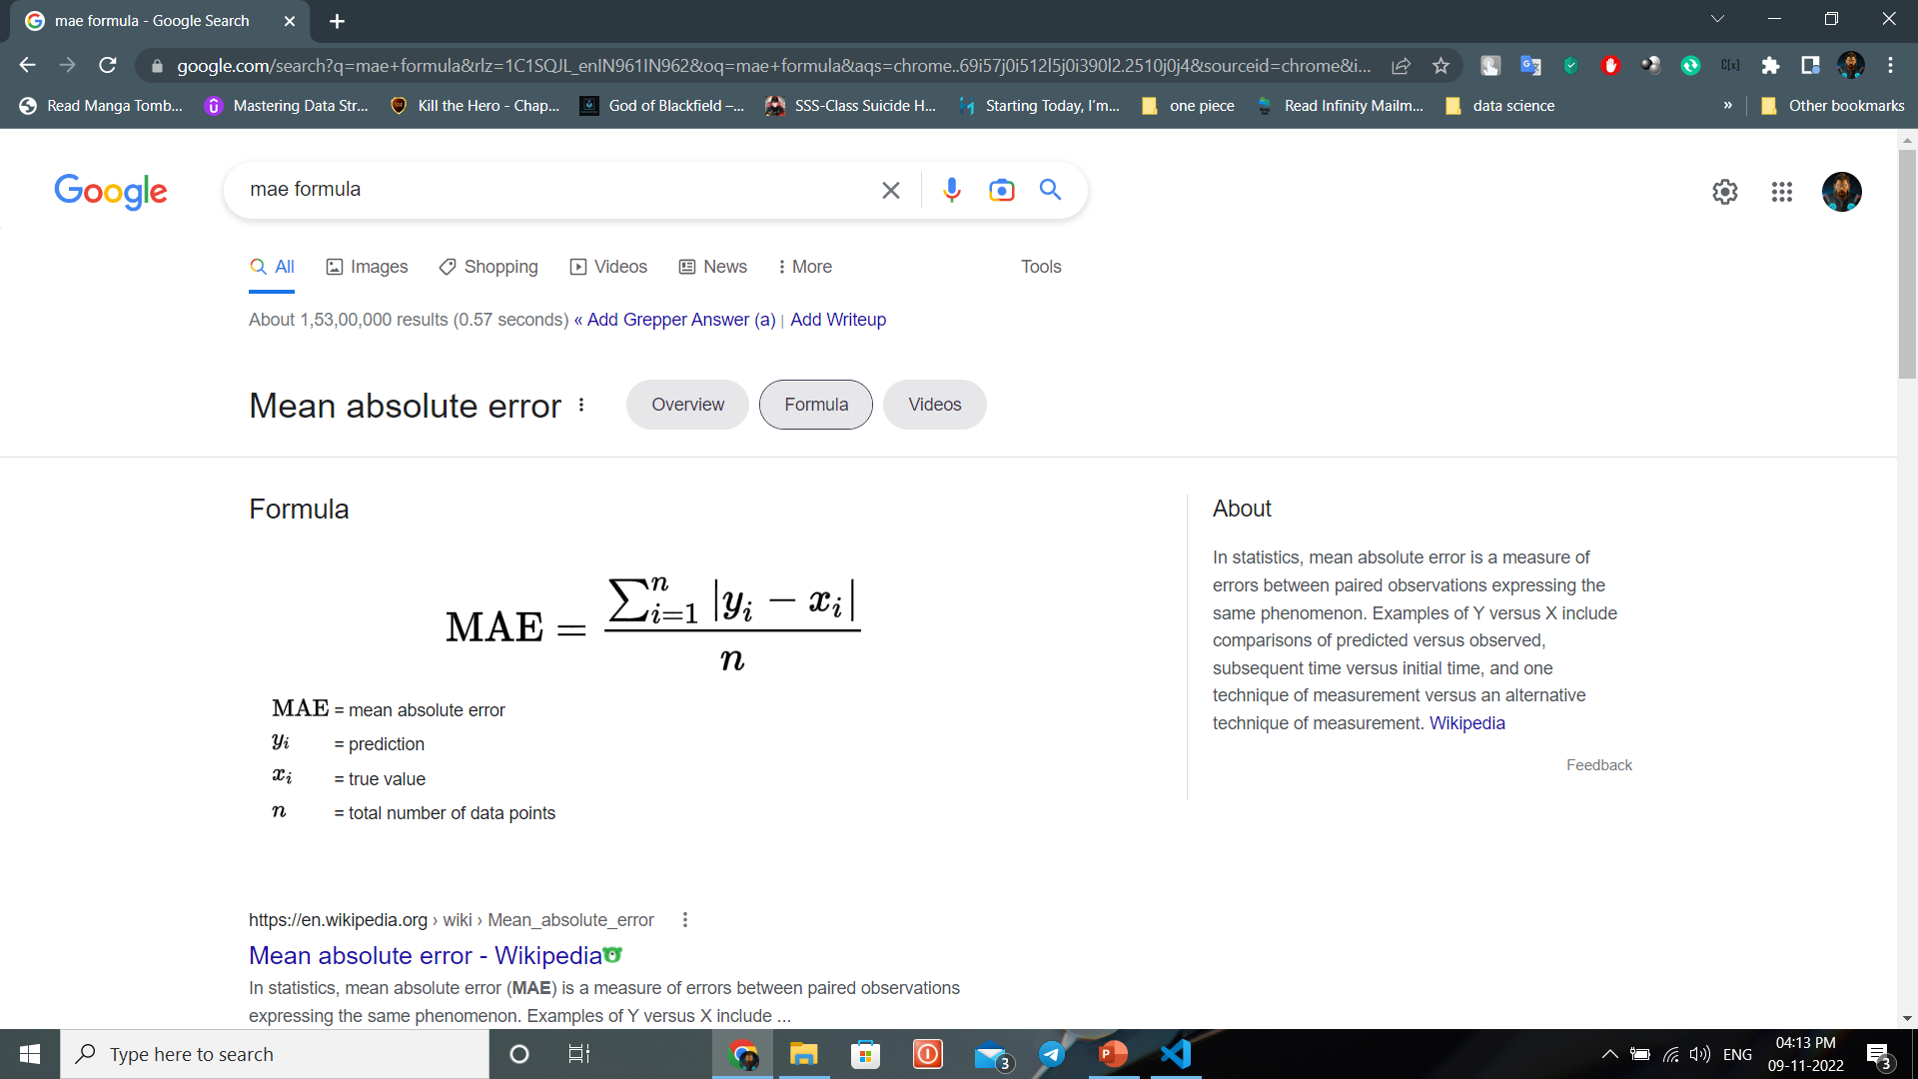
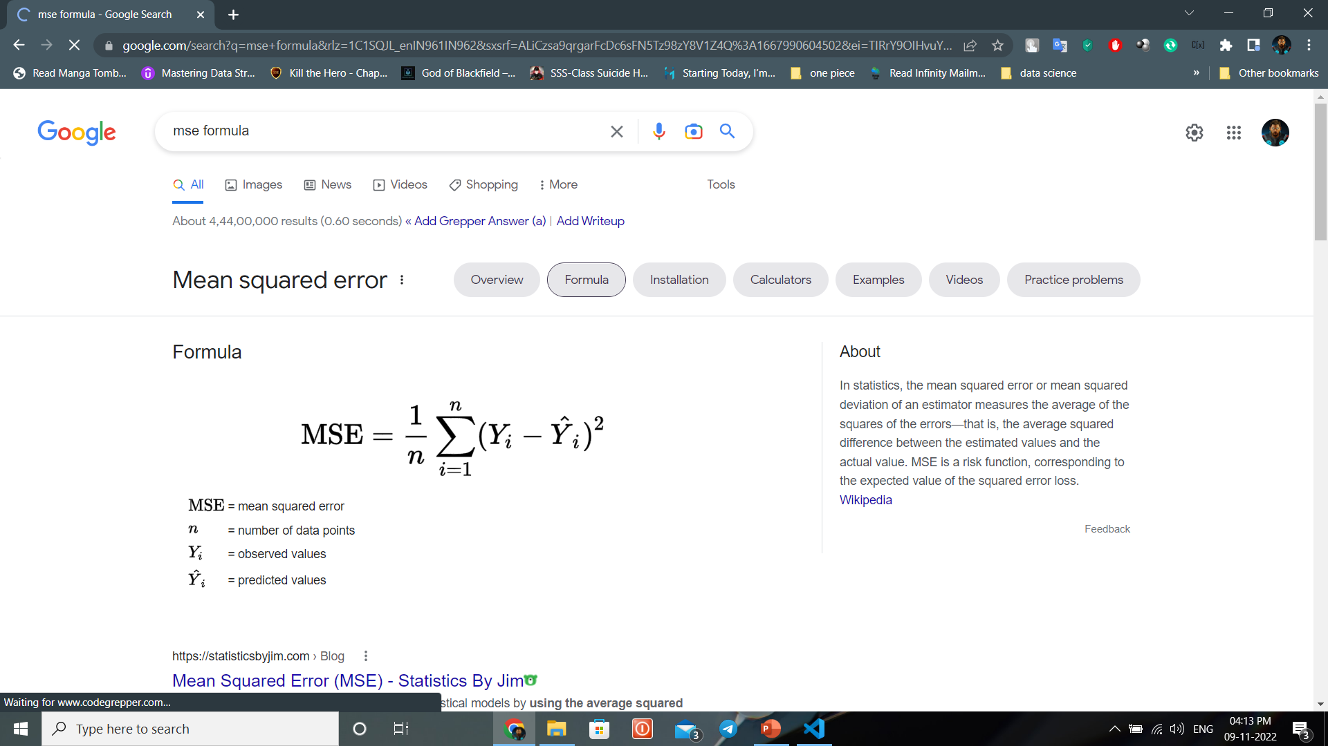
1. Mean Absolute Error :
2. Mean Squared Error :

Slide 31
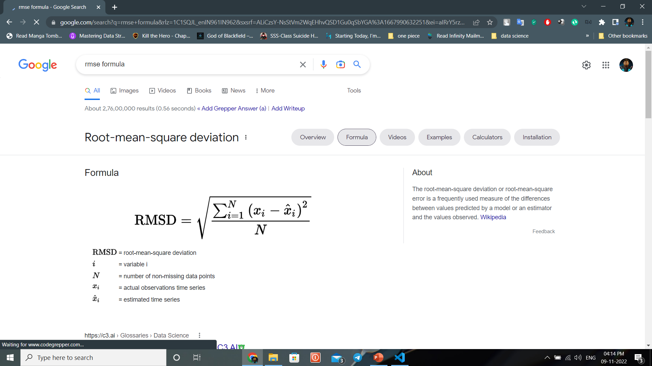
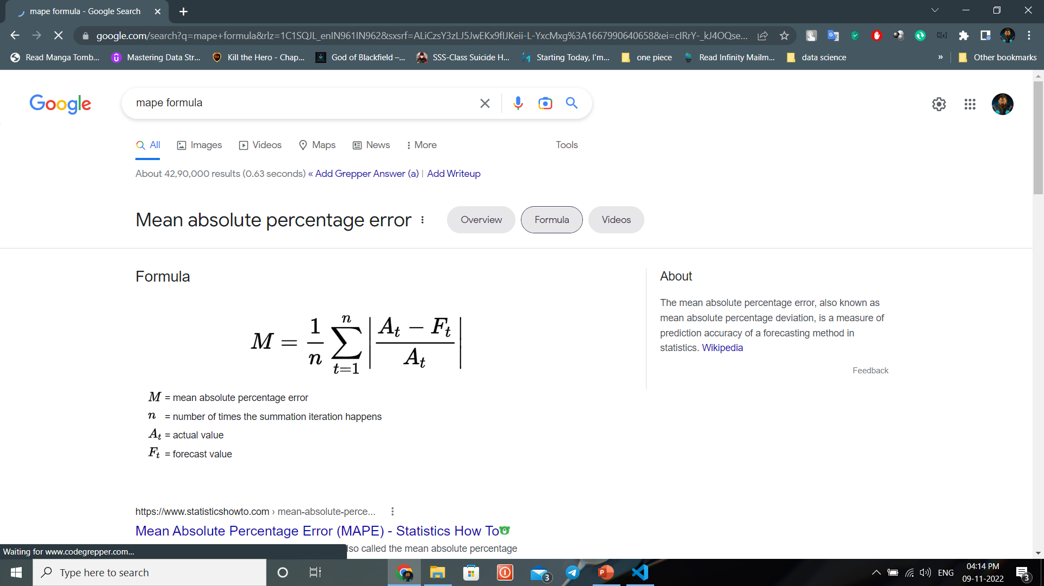
3. Root Mean Squared Error :
4. Mean Absolute Percentage Error :

Slide 32
CONCLUSION :
This project helps for Supermarket owners who wants develop their business.
We have plotted many visualizations from that we got useful insights.
We have applied most of the regression models .

Slide 33


